Slide 1
Malaria Detection using Neural Networks
MIT Bootcamp Capstone Project: Joon Jung

Slide 2
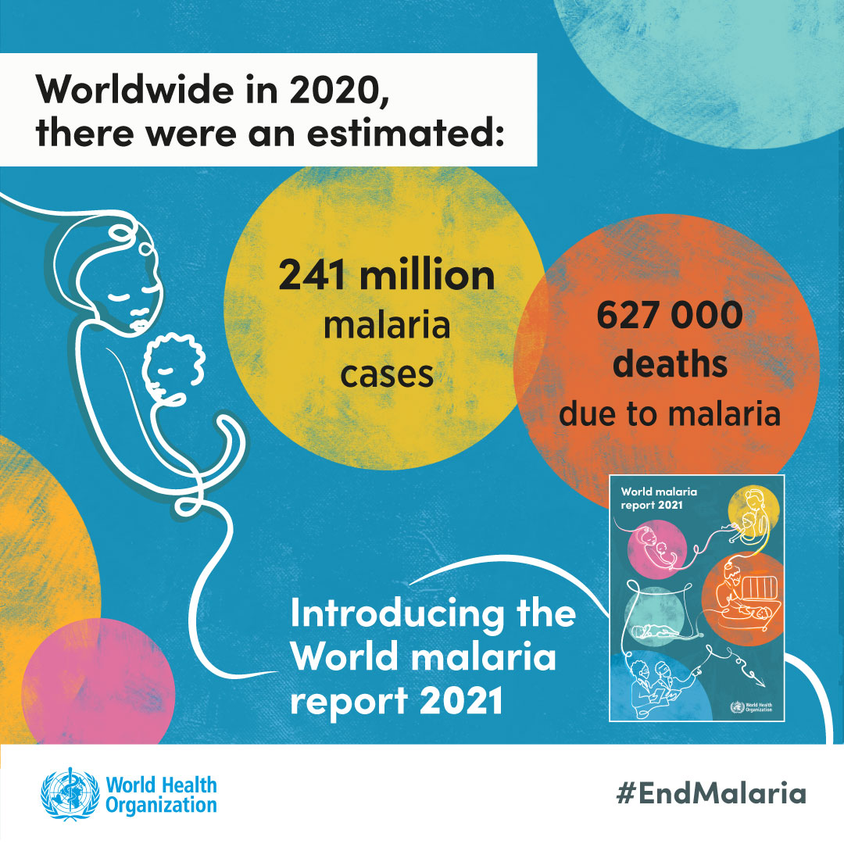
Problem Definition
Malaria is a contagious disease caused by Plasmodium parasites that are transmitted to humans through the bites of infected female Anopheles mosquitoes.
The parasites enter the blood and begin damaging red blood cells (RBCs) that carry oxygen
Almost 50% of world’s population is in danger from malaria.
There were more than 229 million malaria cases and 400,000 malaria-related deaths reported over the world in 2019.
Children under 5 years of age are the most vulnerable population as they account for 67% of all malaria deaths worldwide.
https://www.who.int/teams/global-malaria-programme/reports/world-malaria-report-2021

Slide 3
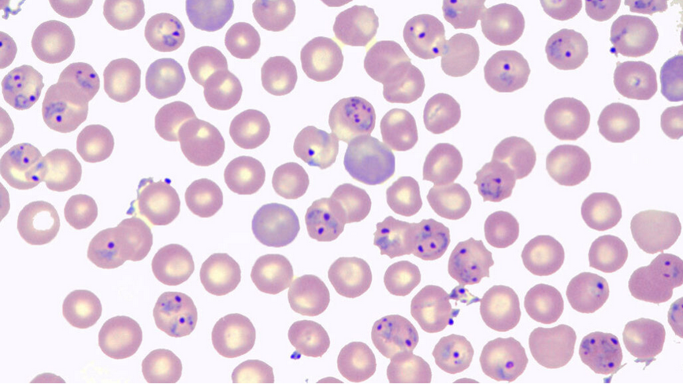
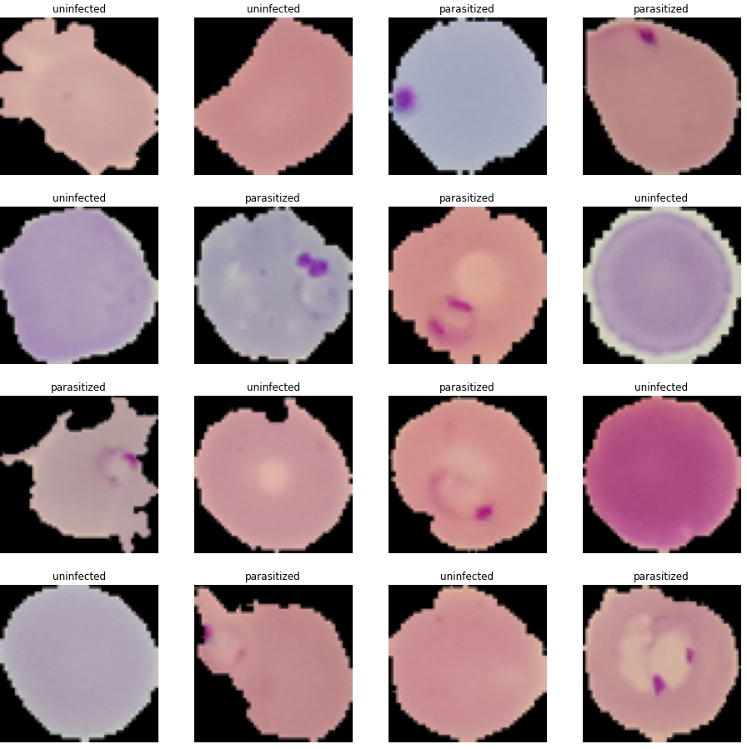
Problem to Solve
Traditional diagnosis of malaria in the laboratory requires careful inspection by an experienced medical professional to discriminate between healthy and infected red blood cells.
Tedious and time-consuming
Depends on human expertise
Can be adversely impacted by inter-observer variability
Automated system can help with the early and accurate detection of the malaria.
Application of automated classification techniques using Machine Learning (ML) and Artificial Intelligence (AI) have consistently shown higher accuracy than manual classification.
Highly beneficial and cost-effective to propose a method that performs malaria detection using Deep Learning Algorithms.
https://www.sciencenews.org/article/malaria-parasites-may-have-their-own-circadian-rhythms

Slide 4
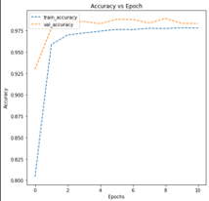
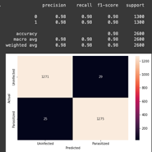
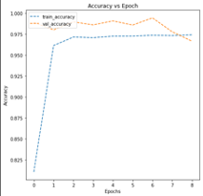
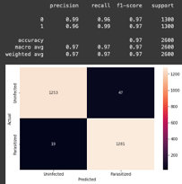
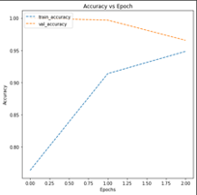
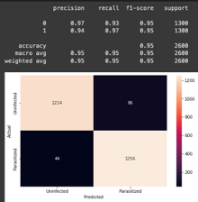
Solution Approach
Base Model
Convolutional Neural Networks (CNNs)
Specialized type of Artificial Neural Network that mainly used with working with image data
Data exploration led to a few key takeaways
Performance Parameter
Accuracy
Validation accuracy
False negative rate (f1_score)
Untreated patient for long periods of time
Late treatment can cause complications and could even be fatal
Base model and adjustments to improve performance
Accuracy graph, classification report, confusion matrix
Advanced
Model with Batch Normalization

Slide 5
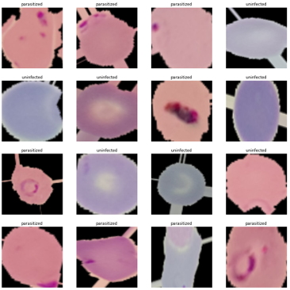
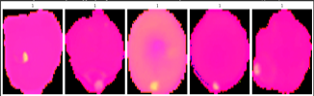
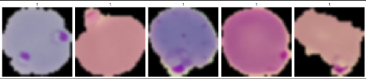
Solution Approach
Model with Data Augmentation
Horizon flip
Zoom
Rotate
HSV
Gaussian Blurring
Can not be determined by Human eyes
Model Accuracy, the performance
HSV
GSB
Horizontal flip, zoom, rotate

Slide 6
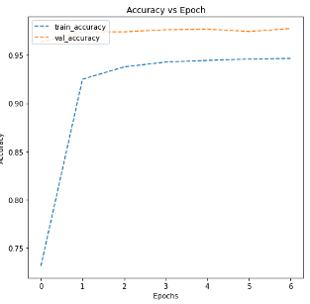
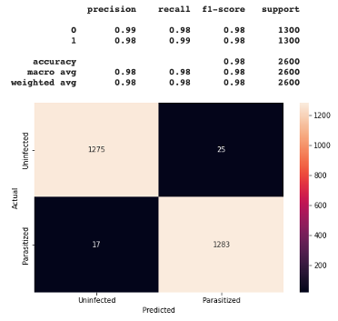
Solution Approach
Achieved the best performance with data augmentation
High accuracy, stable validation accuracy
Low false negative error cases, high f1_score (classification error metric)
Less patients that will be left untreated

Slide 7
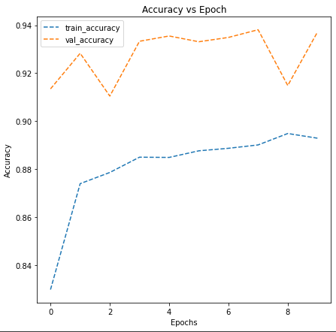
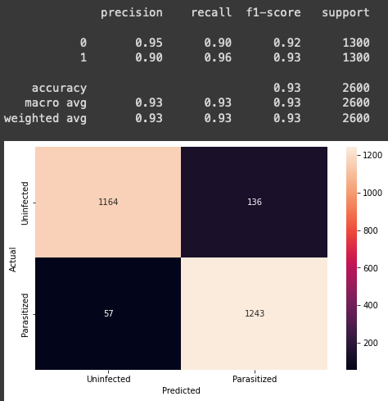
Solution Approach
Performance comparison with well-known, widely used, pre-trained model VGG 16

Slide 8
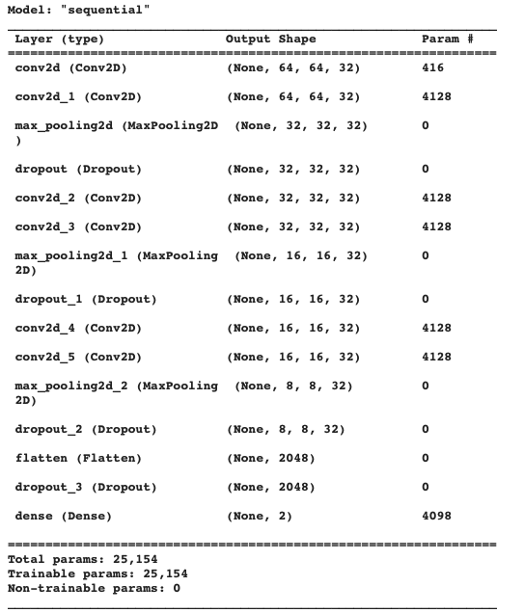
Final Model Solution
CNN model with Data Augmentation
Highest performance with Horizontal flip, zoom, and rotate
Highest performance in accuracy, validation accuracy, false negative cases, and f1_score

Slide 9
Proposed Business Solution
The proposed model should drastically decrease the time that high-paid experienced medical professional needs to spend on manually looking at cells and discriminate between parasitized and uninfected cell
Professional can pay attention to more human-oriented important tasks
Eliminates diagnostic accuracy variability that depended heavily on human expertise
Eliminates inter-observer variability
Eliminates human errors (fatigue, mislabeling, etc)
Can work on off-working hours, holidays, sick days, etc

Slide 10
Risks & Recommendation
Still run the risk of false negative cases, patients that will be left untreated for long periods of time
Need a human expertise or backup model as oversight on negative results
Since our proposed model uses a data augmentation method, when the human expertise is looking back at the images, original cell image may be preferred by human.

Slide 11
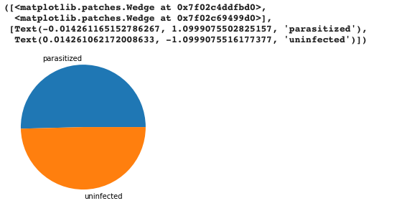
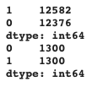
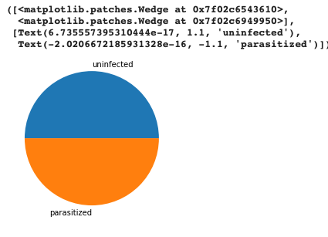
Appendix
Data Exploratory step

Slide 12
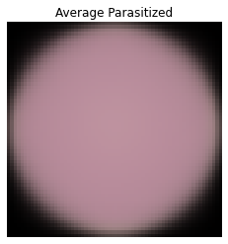
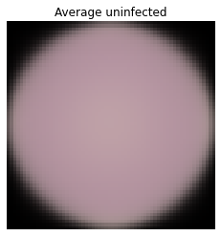
Appendix
Average mean pictures of Parasitized and Uninfected cell pictures

Slide 13
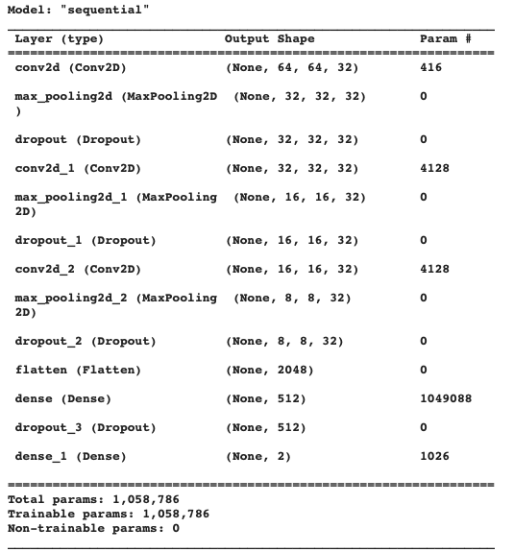
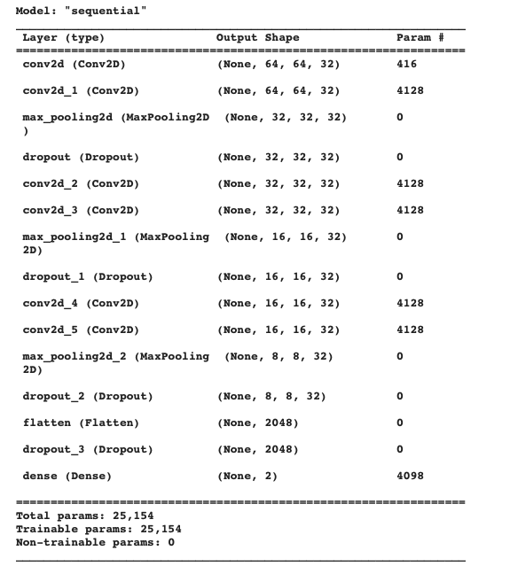
Appendix
CNN layer structure for Base Model and Advanced Model

Slide 14
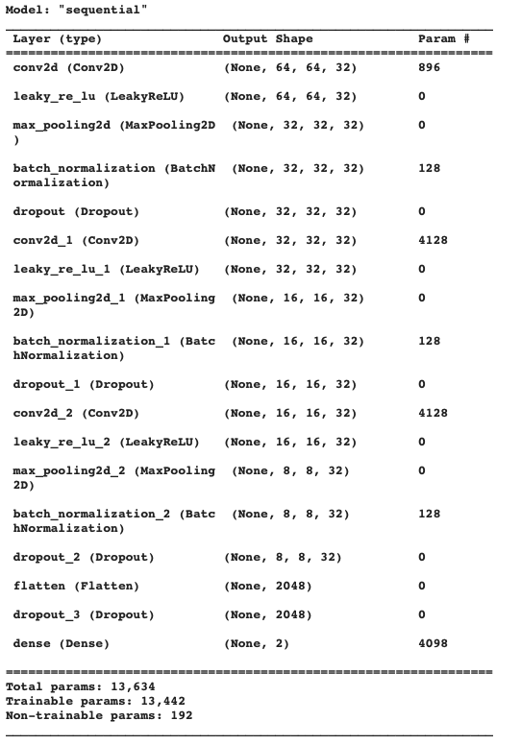
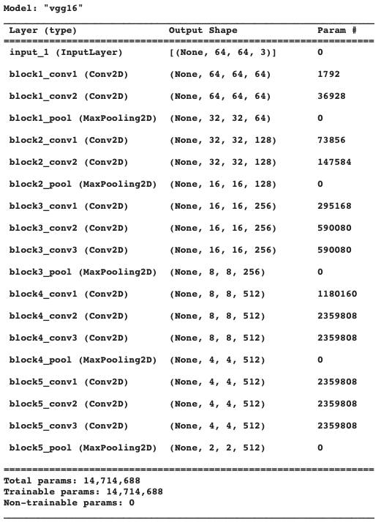
Appendix
CNN layer structure for Batch Normalization Model and pre-trained VGG 16 Model

Slide 15
Thank you!

